Slide 1




Noida Institute of Engineering and Technology, Greater Noida (An Autonomous Institute) School of Computer Science & Engineering in Emerging Technologies
Web Development with MERN Stack using DevOps
Day: 1
Subject Name:
Web Technology ACSC0505
Mr. Praveen Kumar Tomar
Assistant Professor
CSE-AI
Course Details (B Tech. 5th Sem)

Slide 2

Brief introduction of faculty Member
Mr. Amar Pal Yadav
Designation: Assistant Professor CSE-AI
NIET, Greater Noida (Code-133)
Qualification:
M.C.A
M.Tech(CSE),
Specialization: Software Engineering,C,C++,JAVA,A.I
Teaching Experience: 15 years
Research Publication
Paper Published: 10(International Journal)
Coursera Course
Coursera Course Completed: 30

Slide 3

Content
Name of Subject with code, Course and Subject Teacher
Brief Introduction of Faculty member with Photograph
Evaluation Scheme
Subject Syllabus
Branch wise Applications
Course Objective (Point wise)
Course Outcomes (COs)
Program Outcomes only heading (POs)
COs and POs Mapping
Program Specific Outcomes (PSOs)

Slide 4
Conti.....
COs and PSOs Mapping
Program Educational Objectives (PEOs)
Result Analysis (Department Result, Subject Result and Individual Faculty Result)
End Semester Question Paper Templates (Offline Pattern/Online Pattern)
Perquisite/ Recap
Brief Introduction about the Subject with videos
Unit Content
Unit Objective
Topic Objective/Topic Outcome
Lecture related to topic
Daily Quiz
Weekly Assignment

Slide 5
Cont......
Topic Links
MCQ (End of Unit)
Glossary Questions
Old Question Papers (Sessional + University)
Expected Questions
Recap of Unit

Slide 6
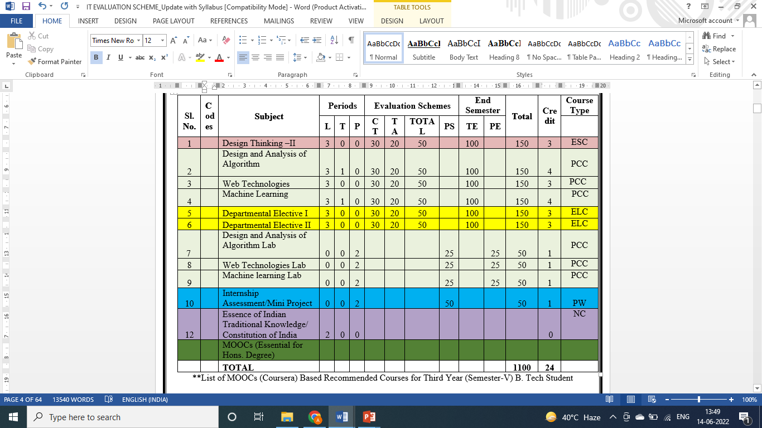
Evaluation Scheme

Slide 7
Syllabus Unit - 1
Introduction: History of Web and Internet, connecting to Internet, Introduction to Internet services and tools, Client-Server Computing, Protocols Governing Web, Basic principles involved in developing a web site, Planning process, Types of Websites, Web Standards and W3C recommendations, Web Hosting Basics, Types of Hosting Packages, Introduction to Web testing, Functional Testing, Usability & Visual Testing, Performance & Load Testing.

Slide 8
Syllabus Unit - 2
HTML: What is HTML, DOM- Introduction to Document Object Model, Basic structure of an HTML document, Mark up Tags, Heading-Paragraphs , Line Breaks, Understand the structure of HTML tables. Lists, Working with Hyperlinks, Image Handling, Understanding Frames and their needs, HTML forms for User inputs. New form Elements- date, number, range, email, search and data list, Understanding audio, video and article tags.
XML: Introduction, Tree, Syntax, Elements, Attributes, Namespaces, Display, HTTP request, Parser, DOM, XPath, XSLT, XQuerry, XLink, Validator, DTD, Schema, Server

Slide 9
Syllabus Unit - 3
Concept of CSS 3: Creating Style Sheet, CSS Properties,CSS Styling(Background, Text Format, Controlling Fonts) , Working with block elements and objects , Working with Lists and Tables , CSS Id and Class, Box Model(Introduction, Border properties, Padding Properties, Margin properties) CSS Advanced(Grouping, Dimension, Display, Positioning, Floating, Align, Pseudo class, Navigation Bar, Image Sprites, Attribute sector) , CSS Color, Creating page Layout and Site.
Bootstrap: Introduction, Bootstrap grid system, Bootstrap Components.

Slide 10
Syllabus Unit - 4
JavaScript Essentials: Introduction to Java Script , Javascript Types , Var, Let and Const Keywords, Operators in JS , Conditions Statements , Java Script Loops, JS Popup Boxes , JS
Events , JS Arrays, Working with Arrays, JS Objects ,JS Functions , Using Java Script in Real time , Validation of Forms, Arrow functions and default arguments, Template Strings, Strings methods, Callback functions, Object de-structuring, Spread and Rest Operator, Typescript fundamentals, Typescript OOPs- Classes, Interfaces, Constructor etc. Decorator and Spread Operator,
Difference == & ===, Asynchronous Programming in ES6, Promise Constructor, Promise with Chain, Promise Race.

Slide 11
Syllabus Unit - 5
Introduction to PHP, Basic Syntax, Variables & Constants, Data Type, Operator & Expressions, Control flow and Decision making statements, Functions, Strings, Arrays,
Working with files and directories: Understanding file& directory, Opening and closing, a file, Coping, renaming and deleting a file, working with directories, Creating and deleting folder, File Uploading & Downloading.
Session & Cookies: Introduction to Session Control, Session Functionality What is a Cookie, Setting Cookies with PHP. Using Cookies with Sessions, Deleting Cookies, Registering Session variables, Destroying the variables and Session.

Slide 12
Text Books
Text books:
1. Steven M. Schafer, “HTML, XHTML, and CSS Bible, 5ed”, Wiley India
2. Ian Pouncey, Richard York, “Beginning CSS: Cascading Style Sheets for Web Design”, Wiley India

Slide 13
Branch Wise Applications
Sample Applications
Desktop GUI Applications
Mobile Applications
Enterprise Applications
Scientific Applications
Web-based Applications
Cloud-based Applications
Web servers and Application servers
Software Tools

Slide 14
Course Objective
This course covers different aspect of web technology such as HTML, CSS, and issues of web technology, client and server side issue.
The general objectives of this course are to provide fundamental concepts of Internet; Web Technology and Web Programming.
Students will be able to build a proper responsive website.

Slide 15
Course Outcome
At the end of the semester, student will be able to:
Course Outcomes (CO) | CO Description | Blooms’ Taxonomy
CO1 | Recalling the basic facts and explaining the basic ideas of Web technology and web hosting. | K1, K2
CO2 | Applying and creating various HTML5 semantic elements and application with working on HTML forms for user input. | K3, K6
CO3 | Understanding and applying the concepts of Creating Style Sheet (CSS)3 and bootstrap. | K2, K3
CO4 | Analysing and implementing concept of Java Script and its applications. | K4, K6
CO5 | Creating and evaluating dynamic web pages using the concept of PHP | K5, K6

Slide 16
Program Outcome
1. Engineering knowledge:
2. Problem analysis:
3. Design/development of solutions:
4. Conduct investigations of complex problems:
5. Modern tool usage:
6. The engineer and society:
7. Environment and sustainability:
8. Ethics:
9. Individual and team work:
10. Communication:
11. Project management and finance:
12. Life-long learning

Slide 17
CO-PO Mapping
Mapping of Course Outcomes and Program Outcomes:
Subject Code is Not Assigned | PO1 | PO2 | PO3 | PO4 | PO5 | PO6 | PO7 | PO8 | PO9 | PO10 | PO11 | PO12
 | 3 | 2 | 2 | 1 | 1 | 1 | 1 | 1 | 3 | 3 | 2 | 3
 | 3 | 2 | 3 | 1 | 3 | 2 | 2 | 1 | 3 | 3 | 3 | 3
 | 3 | 2 | 3 | 2 | 3 | 2 | 2 | 2 | 3 | 3 | 2 | 3
 | 3 | 3 | 3 | 2 | 3 | 2 | 2 | 2 | 3 | 3 | 2 | 3
 | 3 | 3 | 3 | 2 | 3 | 2 | 2 | 2 | 3 | 3 | 2 | 3
Average | 3 | 2.4 | 2.8 | 1.6 | 2.6 | 1.8 | 1.8 | 1.6 | 3 | 3 | 2.2 | 3

Slide 18
Program Specific Outcomes
PSO1: Work as a software developer, database administrator, tester or networking engineer for providing solutions to the real world and industrial problems.
PSO2:Apply core subjects of information technology related to data structure and algorithm, software engineering, web technology, operating system, database and networking to solve complex IT problems.
PSO3:Practice multi-disciplinary and modern computing techniques by lifelong learning to establish innovative career.
PSO4: Work in a team or individual to manage projects with ethical concern to be a successful employee or employer in IT industry.

Slide 19
COs and PSOs Mapping
Mapping of Program Specific Outcomes and Course Outcomes:
Course Outcomes | Program Specific Outcomes
 | PSO1 | PSO2 | PSO3 | PSO4
 | 3 | 3 | 2 | 3
 | 3 | 3 | 3 | 2
 | 3 | 3 | 2 | 2
 | 3 | 2 | 3 | 2
 | 3 | 2 | 2 | 2
AVG | 3 | 2.6 | 2.4 | 2.2

Slide 20
Program Educational Objectives
PEO1: able to apply sound knowledge in the field of information technology to fulfill the needs of IT industry.
PEO2:able to design innovative and interdisciplinary systems through latest digital technologies.
PEO3: able to inculcate professional and social ethics, team work and leadership for serving the society.
PEO4: able to inculcate lifelong learning in the field of computing for successful career in organizations and R&D sectors.

Slide 21
Result Analysis
Web Technology Result of 2022-23: 98.97%
Average Marks: 53.33

Slide 22
End Semester Question Paper Template
B TECH
(SEM-V) THEORY EXAMINATION 20__-20__
Time: 3 Hours Total Marks: 100
Note: 1. Attempt all Sections. If require any missing data; then choose suitably.
SECTION A
Attempt all questions in brief. 1 x 10 = 10
Q.No. | Question | Marks | CO
1 |  | 1
2 |  | 1
. |  | .
10 |  | 1

Slide 23
End Semester Question Paper Templates
2. Attempt of the following: 5 x 2 = 20
SECTION B
3. Attempt any five part of the following: 5 x 6 = 30
Q.No. | Question | Marks | CO
1 |  | 2
2 |  | 2
“”” |  | ‘”
5 |  | 2
Q.No. | Question | Marks | CO
1 |  | 6
. |  | 6
7 |  | 6

Slide 24
End Semester Question Paper Templates
4. Attempt any one part of the following: 1 x 10 = 10
5. Attempt any one part of the following: 1 x 10 = 10
6. Attempt any one part of the following: 1 x 10 = 10
Q.No. | Question | Marks | CO
1 |  | 10
2 |  | 10
Q.No. | Question | Marks | CO
1 |  | 10
2 |  | 10
Q.No. | Question | Marks | CO
1 |  | 10
2 |  | 10

Slide 25
End Semester Question Paper Templates
7. Attempt any one part of the following: 1 x 10 = 10
8. Attempt any one part of the following: 1 x 10 = 10
Q.No. | Question | Marks | CO
1 |  | 10
2 |  | 10
Q.No. | Question | Marks | CO
1 |  | 10
2 |  | 10

Slide 26
Prerequisite
Basic Knowledge of any programming language like C/C++/Python/Java.
Familiarity with basic concepts of Internet.

Slide 27
Brief Introduction About The Subject
Web technologies are the various tools and techniques that are utilized in the process of communication between different types of devices over the internet.
To understand this term in a better manner, let’s break it down into two pieces: ‘web’ and ‘technology’.
The web, in this case, refers to the World Wide Web, more commonly known as WWW.
It first came into being in 1989 when famous scientist and engineer, Tim Berners-Lee, came up with an efficient mechanism to share resources between scientists all over the world.
https://www.youtube.com/results?search_query=Web+Technonogies

Slide 28
Unit 1 Content
Introduction:
Introduction to Web Technology
History of Web and Internet
Connecting to Internet
Introduction to Internet services and tools
Client-Server Computing, Protocols Governing Web
Basic principles involved in developing a web site
Planning process
Types of Websites
Web Standards and W3C recommendations,

Slide 29
Unit 1 Content(cont1..)
Web Hosting Basics
Types of Hosting Packages
Introduction to web testing
Functional Testing
Usability & Visual Testing
Performance & Load Testing

Slide 30
Unit Objective
Objective of Unit 1:
To learn about web development strategies with protocols governing web and internet services and tools.
To understand the basic concepts to develop the website as per web standards and W3C recommendations.
To understand web hosting and web hosting packages.
To understand to register a domain and maintain web servers.

Slide 31
Introduction to Web Technology
Web Technology refers to the various tools and techniques that are utilized in the process of communication between different types of devices over the internet.
A web browser is used to access web pages.
Web browsers can be defined as programs that display text, data, pictures, animation, and video on the Internet.

Slide 32
Classification of Web technology
World Wide Web (WWW)
Web Browser
Web Server
Web Pages
Web Development

Slide 33
History of Web development and Internet
World Wide Web
The World Wide Web is a system of interlinked hypertext documents accessed via the Internet. Web is a huge collection of pages of information linked to each other around the globe.
History of WWW:
WWW is created by Sir Tim Berners Lee in 1989 at CERN in Geneva.
In 1990, the first text only browsers were setup and CERN scientist.
To transfer HTML document to remote sites a new protocol was devised called HTTP (Hyper Text Transfer Protocol).

Slide 34
Contd….
In the fall of 1991, conference goes around the world started hearing about
the promise but sparks still were not flying.
In 1993, there are only about 50 websites world wide.
A browser that allowed user to take advantage of the web’s graphical
capabilities was developed at the National center for Super Computing application (NCSA).
NCSA called the browser Mosaic.

Slide 35
Connecting to Internet
When determining which type of Internet speed and Internet connection type is right for you or your family, it's important to understand the distinction between each connection.
In today's age, there are numerous ways to connect laptops, desktops, mobile phones, gaming consoles, e-readers and tablets to the Internet.
MOBILE
WIFI HOTSPOTS
DIAL-UP
BROADBAND
DSL(DIGITAL SUBSCRIBER LINE)
CABLE
SATELLITE

Slide 36
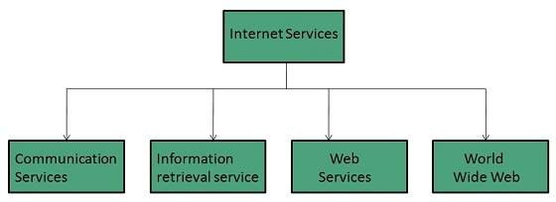
Introduction to Internet services and tools
Internet Services allows us to access huge amount of information such as text, graphics, sound and software over the internet.

Slide 37
Protocols Governing Web
Protocol
A protocol is a set of rules to communicate applications to each other.
A protocol is the interface required for communicating the different applications
Classification of Protocols
HTTP
TCP/IP
FTP
SMTP
TELNET

Slide 38
Protocols Governing Web(cont1..)
HTTP Protocol
HTTP is the primary protocol used to distribute information on the web
Initial HTTP 0.9 does not allow for content typing and does not have provisions for supplying meta- information.
Content Typing is to identify the type of data being transferred.
Meta Information is supplemental data, such as environment variables that identify the client’s computer

Slide 39
Protocols Governing Web(cont1..)
TCP/IP
It is a set of rules that an application can use to package its information for sending across the networks of networks.
FTP
FTP uses TCP to create a virtual connection for control information and then creates a separate TCP connection for data transfers.
It is used to transfer the files over networks.

Slide 40
Protocols Governing Web(cont1..)
SMTP
It is an Internet standard for electronic mail (e- mail) transmission across Internet Protocol (IP) networks.
Telnet
This protocol used to remotely login into another system .
This is used to browse file and directories on the remote system.

Slide 41
Daily Quiz
1.) The HTML and HTTP standard are defined by __
(A) Web client
(B) Internet association
(C) WWW consortium
(D) WWW
2.) The ____ passes the information given by the user to a specified program.
(A) User
(B) Programmer
(C) Web server
(D) Browser
3.) Which language is used for creating Web Pages?
(A) PASCAL
(B) C
(C) HTML
(D) BASIC

Slide 42
Daily Quiz
4.) What is the abbreviation of HTTP?
(A) Hypertext tag path
(B) Hyper Text Transfer Protocol
(C) Hypertext transfer path
(D) None
5.) The entire web document is contained within ____
(A) Comments
(B) Tags
(C) Web page
(D) HTML element

Slide 43
Types Of Websites
Website:
A website is simply a collection of interlinked web pages.
Classification of Website
Corporate Website
Individual website

Slide 44
Websites
Corporate Website:
In this, there is certain no. of persons, who develop their website for a particular organization.
The corporate website are formed when group of people have common interest and objective.
The purpose of this website is to convey the information of organization to all over the world

Slide 45
Websites(cont1..)
Individual Website
Personal web pages are world wide web pages created by an individual to contain content of a personal nature rather than content pertaining to a company, organization or institution.
It is just like profile management system.
In this type of website an individual wants to develop website for
hi-projection, career growth etc.

Slide 46
Web Applications
Web application is a kind of application that can be through the web browser over the internet.
Web applications may include simple office software word processors, Google docs, project management, computer-aided design, online spreadsheets, and presentation tools.
Some common scripting languages are used to create web applications such as JSP, ASP and PHP.
Web applications interact with program variables ,spreadsheets and databases using user input for creating the dynamic web content.

Slide 47
Web Applications(cont1..)
Examples of Web Application
Airline Reservation System.
Message Boards.
Shopping Cart.
Net-banking.

Slide 48
Writing a Web Projects
Objective of above Topic:
To developed web project and understand the concepts of web project development differs from traditional web projects
Phases of writing the web projects
Write a project mission statement
Write the specific mission statement that you want to do.
Identify Objectives
Specific
Measurable
Attainable
Realistic
Time limited

Slide 49
Writing a Web Projects(cont1..)
Phases of writing the web projects(cont..)
Identify your target users
The matter of a website will be determined by the users whom you want to visit the site. This is totally depending upon
Market research
Focus group
Understanding the audiences
Determine the scope
By supporting documents and client’s approval.

Slide 50
Writing a Web Projects(cont1..)
Phases of writing the web projects(cont..)
Budget
Assumption for budgets.
Budget categories.
Determine hidden costs and tools.
Planning issues:
Discuss client’s existing information system.
Project team and developing infrastructure.
Where the website will place.

Slide 51
Connecting To Internet
Telephone
A Telephone is a device that converts voice communication into electrical signals that can be transferred to other telephones and heard.
Telephones enable people to communicate with other people all over the world and is widely credited as being first invented by Alexandra Graham Bell in 1876.
There are three basic phones in use today. The classic corded telephone, which could be rotary dial like or have buttons, the cordless or wireless phone, and the cell phone

Slide 52
Connecting To Internet(cont1..)
Cable
A cable is one or more wires covered in a plastic covering that connects a computer to a power source or other device.
Two Types of computer cables
A data cable is a cable that provides communication between devices.
For example, the data cable that connects your monitor to your computer and allows your computer to display a picture on the monitor such as SATA and USB etc.
A power cable is any cable that powers the device.

Slide 53
Connecting To Internet(cont1..)
Types of Cables:
AT - Used with early keyboard.
ATA - Used with hard drives and disc drives.
CAT5 - Used with network cards.
Coaxial -Used with TV and Projectors.
DVI - Used with Monitors Projectors, and other display
E-SATA - Used with external drives.

Slide 54
Connecting To Internet(cont1..)
Types of Cable
MDI - Used with musical keyboards and other equipment.
Mini Plug - Used with headphone, microphone and speakers.
Molex - Power cable used inside your computer.

Slide 55
Connecting To Internet(cont1..)
Satellite Connection
A satellite connection uses broadband but does not require cable or phone lines.
It connects to the Internet through satellites orbiting the Earth.
It can be used almost anywhere in the world, but the connection may be affected by weather patterns.

Slide 56
Connecting To Internet(cont1..)
Satellite Connection(cont..)
A satellite connection also relays data on a delay, so it is not the best option for people who use real-time applications, like gaming or video conferencing.
A satellite Internet connection is an arrangement in which the upstream (outgoing) and the downstream (incoming) data are sent from, and arrive at, a computer through a satellite.

Slide 57
Daily Quiz
1.) A program that is used to view websites is called a
(A) Browser
(B) Web viewer
(C) Spreadsheet
(D) Word processor
2.) Which of the following is not a type of broadband internet connection?
(A) Satellite
(B) DSL
(C) Dial up
(D) Cable
3.) Servers are computers that provide resources to other computers connected to a
(A) Client
(B) Mainframe
(C) Supercomputer
(D) Network

Slide 58
Daily Quiz
4.) Sending an E-mail is similar to
(A) Sending a package
(B) Talking on the phone
(C) Writing a letter
(D) Drawing a picture
5.) ARPANET stands for
(A) Advanced Rehearse Projects Agency Network
(B) Advanced Research Projects Agency Newark
(C) Advanced Research Projects Agency Network
(D) None of these
6.) The process of connecting to the internet account is
(A) Sing in
(B) Sing out
(C) Login
(D) Logout

Slide 59
Introduction to Internet services and tools
Introduction To Internet Services
Common Protocol Used To Provide Internet Services
The File Transfer Protocol (FTP) is a standard network protocol used to transfer computer files from one host to another host over a TCP-based network, such as the Internet
Telnet is a network protocol used on the Internet or local area networks to provide a bidirectional interactive text-oriented communication facility using a virtual terminal connection.

Slide 60
Introduction to Internet services and tools
Introduction To Internet Services(cont..)
RSH Remote Shell allows you to send single commands to the remote server.
RCP Remote Copy provides the capability to copy files to and from the remote server without the need to resort to FTP or NFS (Network File System, the UNIX form of folder sharing
NNTP(Network News)-( Reading and posting USENET news)

Slide 61
Introduction to Internet services and tools
Introduction To Internet Services(cont..)
HTTP(Hypertext Transfer Protocol)-(Transferring documents on the Web)
SMTP(Simple Mail Transfer Protocol)- (Sending mail)
POP3(Post Office Protocol)- (Reading Mail)
Post Office Protocol (POP) protocol used by local e-mail clients to retrieve e-mail from a remote server over a TCP/IP connection.

Slide 62
Introduction to client-server computing
Client/Server Definition
In client/server computing “server software accepts requests for data from client software and returns the results to the client”
Elements of C-S Computing
A Client
A Server
And a network
In client-server computing major focus is on SOFTWARE

Slide 63

Introduction to client-server computing
A Client/Server Computing

Slide 64
Introduction to client-server computing
Categories of Server
File Server
File Servers manage a work group’s application and data files, so that they may be shared by the group.
Data Server
It used only for data storage and management
Compute Server

Slide 65
Introduction to client-server computing
Categories of Server(cont..)
Database Server
Accepts requests for data, retrieves the data from its database
Communication Server
Provides gateway to other LANs, networks & Computers

Slide 66
Daily Quiz
1.)----- is whatever you’re using to interact with the internet
(A) client
(B) HTTP
(C) server
(D) navigation
2.) The-------is about communication between web clients and web servers.
(A) client
(B) HTTP
(C) server
(D) navigation
3.) Communication between client computers and web servers is done by sending ---
and receiving-------
(A)client server
(B) HTTP request HTTP responses
(C) server client
(D) navigation browser

Slide 67
Daily Quiz
4.) A client (a browser) sends an---------to the web
(A) client
(B) HTTP Request
(C) server
(D) navigation
5.) The-------request to the server for any information
(A) client
(B) HTTP
(C) server
(D) navigation
6.) The--------provide the information to the client
(A)client server
(B) HTTP request HTTP responses
(C) server
(D) navigation browser

Slide 68
Previous Topics: Recap
Protocols governing web, and internet services and tools that connect to the internet.
It was also discussed about the history of web.
We had also discuss Cyber Laws and Website and its classification

Slide 69
Previous Topics: Recap(Cont..)
The above topic was focused on the Web Application with its examples and phases.
It was also discussed about the connection of Internet through:-
Telephone
Cables and its types
Satellite Connection.
We have also discussed about the client server computing and Categories of Server.
How to write the web project in the previous topic

Slide 70
Topic Objective/Outcome
Topics: Web Hosting Basics, Types of Hosting Packages,
Introduction to Web testing, Functional Testing,
Usability & Visual Testing, Performance & Load Testing. (CO1 )
Objective of the above topics:
To know the basics of web hosting and hosting packages.
To get the knowledge about Web Testing.
To learn how testing is used in a web server and how to test a website?

Slide 71
Web Hosting Basics
When a hosting provider allocates space on a web server for a website to store its files, they are hosting a website.
Web hosting makes the files that comprise a website (code, images, etc.) available for viewing online.
web hosting is the process of renting or buying space to house a website on the World Wide Web.
Website content such as HTML, CSS, and images has to be housed on a server to be viewable online.
Web hosting service providers have the servers, connectivity, and associated services to host websites.
Choosing the right hosting plan will mean having access to the right allocation of resources to keep your website loading quickly and reliably for your visitors.

Slide 72
Types of Hosting Packages
There are the six types of web hosting:
Shared hosting
Virtual private server (VPS) hosting
Dedicated server hosting
Cloud hosting
Managed hosting
Colocation
Shared hosting
Shared hosting allows multiple websites to utilize a single server. Usually, you’ll have no idea who or what websites you’re sharing the resources of a server with. Each customer will usually have a limit on the total amount of server resources they can use, but this will be defined by your hosting package.
Shared hosting is easily the cheapest and most economical option for your needs. However, the cheap price comes with limitations, which we’ll get to below. Since most hosting companies will offer the same amount of space and storage it’s important to choose a company you can trust.

Slide 73
Types of Hosting Packages
Virtual private server (VPS) hosting
A VPS hosting plan is the ultimate middle ground between a shared server and a dedicated server.
It’s ideal for website owners that need more control, but don’t necessarily need a dedicated server.
VPS hosting provides website owners with more customization and storage space, but still they are not able to handle incredibly high traffic levels or spikes in usage meaning that the site performance can still be affected by other sites on the server.
VPS hosting is used by website owners who want dedicated hosting but don’t have the technical knowledge needed.
VPS hosting offers the cost benefits of shared hosting with the control of dedicated hosting.

Slide 74
Types of Hosting Packages
Dedicated server hosting
Dedicated hosting gives website owners the most control over the server that their website is stored on.
Customer has full root and admin access, so he can control everything from security to operating system that you run.
Dedicated servers cost are one of the most expensive web hosting options.
Used by website owners with high levels of website traffic, and those who are in need of complete control of their servers.
A high level of technical expertise is required for the installation and ongoing management of the server.
Cloud hosting
It’s a hosting solution that works via a network and enables companies to consume the computing resource like a utility.
This allows users to employ as many resources as they need without having to build and maintain their own computing infrastructure.
Cloud-based hosting is scalable, meaning your site can grow over time, using as many resources as it requires and while the website owner only pays for what they need.

Slide 75
Types of Hosting Packages
Managed hosting
Hosting companies provide technical services such as hardware and software setup and configuration, maintenance, hardware replacement, technical support, patching, updating and monitoring.
With managed hosting, the provider looks after the day-to-day management of the hardware, operating systems and standardized applications.
Colocation
Instead of keeping servers in-house or at a private data center, you may choose to ”‘co-locate” your equipment by renting space in a colocation center.
he center will provide the power, bandwidth, IP address and cooling systems that your server requires. Space is rented out in racks and cabinets.
Colocation gives access to higher levels of bandwidth than a normal office server room at a much lower cost.
You’re left to your own devices (literally) and will be expected to take care of everything including the hardware, software and services.

Slide 76
Introduction to Web Testing
Web testing, at its core, is simply checking your web application or your website for problems before you make that web application or website live. Web testing is designed to check all aspects of the web application’s functionality, including looking for bugs with usability, compatibility, security, and general performance.
Web testing is a crucial part of assembling any web application or website, as you don’t want to invest the many resources in time and money you’ve spent developing this web application and then have it run into immediate problems upon release. We have seen that happen before, and it isn’t pretty.

Slide 77
Functional Testing
Functional testing is a stage in the software delivery lifecycle (also referred to as a ‘process’) in which quality engineers verify whether the application under test’s features behaves as per their requirements.
Here are some typical examples of functional testing:
Do appropriate error messages appear when users input the incorrect information (e.g. invalid email address, card number)?
Can users request to change their credentials (e.g. user name, passwords, etc.,...)?
Can users log in with the new credentials?

Slide 78
Functional Testing Vs Non Functional Testing
 | Functional Testing | Non-functional testing
Method | Normally performed under the black-box method. In which the testers only validate with inputs and outputs instead of the internal structure of the system. | Normally performed under the white-box method. In which the tester is made aware of the system’s internal design to generate test cases accordingly.
Areas of concern | Whether or not the system’s outputs satisfy the specification or requirements given | The system’s performance, stability, security, usability, etc.
Inputs | Business requirements, client’s specifications | Speed, throughput, scalability, etc.
Examples | Unit testing API testing Regression testing (can be both functional and non-functional) | Security testing Performance testing Load testing Stress testing

Slide 79
Usability & Visual Testing
Usability testing refers to evaluating a product or service by testing it with representative users. Typically, during a test, participants will try to complete typical tasks while observers watch, listen and takes notes. The goal is to identify any usability problems, collect qualitative and quantitative data and determine the participant's satisfaction with the product.
To run an effective usability test, you need to develop a solid test plan, recruit participants, and then analyze and report your findings.

Slide 80
Visual Testing
Visual testing is a software testing technique that evaluates the visual appearance and behavior of a software application’s user interface (UI) or graphical user interface (GUI). Visual testing aims to verify that the application’s visual elements like colors, images, fonts, and layouts, are displayed correctly and consistently across different devices, operating systems, and browsers.​
Visual testing ensures that the user interface (UI) of the developed product appears as intended for users. It accomplishes this through several key benefits, including:
Identifying defects or issues in the UI interface.
Detecting variations in the UI that do not match the baseline snapshots.
Creating specialized visual test cases that cover functional points.
Identify visual bugs on different browsers.

Slide 81
Performance & Load Testing
Performance testing is a type of testing that is performed for verifying the performance of a system and to monitor the behavior of the system under stress. It tells about the reliability, stability, response time, and scalability of a system. On the other hand, load testing is primarily aimed for identifying the behavior of a system under the expected load.
What is Performance Testing?
Performance testing is performed over the software to test its performance under a particular workload for its sensitivity, reaction time and its stability. Performance testing is basically a superset of stress testing.
The primary goal of performing performance testing is to set the standards and benchmarks for the product. Performance testing indicates how the product behaves under regular parameters. Checking for concurrent users and response time is an example of performance testing.

Slide 82
Performance & Load Testing
Load testing checks the performance of a software to check its performance under real life-based loads. In other words, load testing is a type of testing that checks the behavior of a system under the expected load. To perform the load testing of a system, we first need to know the expected load on the application in real life.
Load testing collects all the data about response time, reliability, and stability of the system, and then analyzes the data to find the inconsistencies. Basically, the load test is performed to ensure the stable operation of a system under an expected load.
The greatest advantage of load testing is that it helps in understanding the expected load that a system can handle so that we can reduce the risk of a failure.

Slide 83
Performance & Load Testing
The following are some of the important differences between Performance Testing and Load Testing −
Key | Performance Testing | Load Testing
Purpose | Performance testing tests the system performance under varying loads. | Load testing tests the system performance for multiple users using the application at the same time.
Threshold | Performance testing is conducted at below and above threshold limits. | Load testing is conducted at threshold limits.
Result | Performance testing ensures that the system is performing perfectly under varying loads. | Load testing ensures that the system can handle how many users at a time without performance degradation.
Result | Performance testing checks the performance of the system. | Load testing checks the operational capacity of the system.
Cost | Performance testing tools are not much costly. | Load testing tools are very costly.
Targets | Performance testing checks the reliability, scalability, and speed of the system. | Load testing checks the sustainability of the system.

Slide 84
Daily Quiz
What are shared on the Internet and are called as Web pages?
Programs
Cables
Hypertext documents
None
What is the name of the location address of the hypertext documents?
Uniform Resource Locator
Web server
File
Web address

Slide 85
Daily Quiz(cont..)
Which of the following is true about public access modifier?
Variables, methods and constructors which are declared public can be accessed by any class.
Variables, methods and constructors which are declared public can be accessed by any class lying in same package.
Variables, methods and constructors which are declared public in the superclass can be accessed only by its child class.
None of the above.
Which program is used by web clients to view the web pages?
Web browser
Protocol
Web server
Search Engine

Slide 86
Daily Quiz(Cont..)
The following “Things to consider” while planning a website:
(i) Purpose of website (ii) Target audience
(iii) Website contents (iv) All of these
(b) The initial stage of planning your website is to:
(i) Identify the target audience (ii) Identity the Purpose of the Site
(iii) Budgeting (iv) Prepare Blue Print
(c) Which of following are the are web site design consideration and principles?
(i) Easy to read (ii)Easy to navigate
(iii) Quick download (iv) All of these

Slide 87
Weekly Assignment
Explain the following: [CO1]
URL
domain name space
Domain name server
Explain the term protocol. List all the commonly used web protocols. [CO1]
Explain the role of web server on the internet. [CO1]
Explain the working of web with proper diagram. [CO1]
Give examples of each: static and dynamic website.[CO1]
Describe domain name space and domain name server. [CO1]
Describe all the steps of web site hosting. [CO1]
Explain Hypertext and Hypermedia. [CO1]
What do you understand by a markup language? List all the types of markup languages. [CO1]
Explain HTML with basic structure of an HTML document. [CO1]

Slide 88
MCQ s
Who is making web standards
Netscape
Microsoft
WWWC
Range of Heading tags in HTML
<h1> to <h3>
<h1> to <h8>
<h1> to <h6>
<h1> to <h9>
What does HTML stand for ?
Hyperlinks and Text Markup Language
Home Tool Markup Language
Hyper Text Markup Language
Home Text Markup Language

Slide 89
MCQ s(Cont..)
Web is a huge collection of ………..of information linked to each other around the globe.
Pages
Website
HTML
Father of WWW
J.T. Thomson
Dennis Ritchie
Tim Berners-Lee
Who is responsible for creating the look and feel of a site?
Creative Lead
Programmer
Analyst
Designer

Slide 90
MCQ s(Cont..)
Which of the following are information retrieval services on the internet? i) World Wide Web ii) File Transfer Protocol iii) Telnet iv) Email A) i, ii and iv only B) ii, iii and iv only C) i, ii and iii only D) All i, ii, iii and iv . ………….. allows remote accessing to the files which contain programs, technical handouts, reports etc. A) Remote Desktop B) FTP C) Telnet D) Chat

Slide 91
Glossary Questions
………….. allows remote accessing to the files which contain programs, technical handouts, reports etc. A) Remote Desktop B) FTP C) Telnet D) Chat ……………. is a global hypertext system that was initially developed in 1989 by Tim Berners Lee. A) FTP B) Telnet C) www D) email
The ……………. application is built with a protocol interpreter, a data transfer, process and user interface. A) TCP B) FTP C) Telnet D) Chat

Slide 92
Glossary Questions
ARPANET used the concept of packet switching network consisting of subnet and …………… computers. A) local B) remote C) host D) network
Internet was possible because of the use of the TCP/IP reference model and ……………… protocol stack. A) FTP B) TCP/IP C) DHCP D) UDP
………………. was created for organizing machines into domains and map hostname onto IP address. A) Domain Addressing System B) Domain Naming System C) Host Naming System D) Domain Mapping System

Slide 93
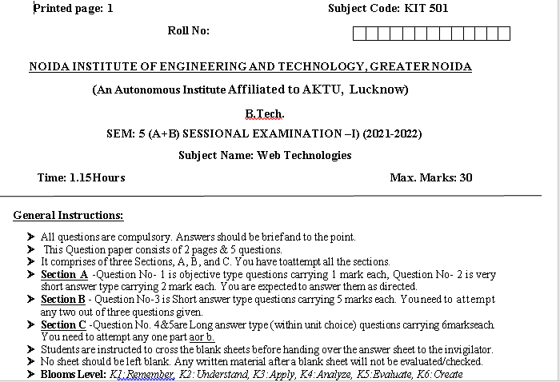
Sessional Papers

Slide 94
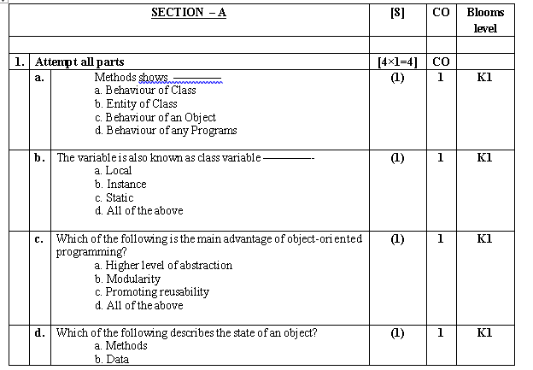
Sessional Papers

Slide 95
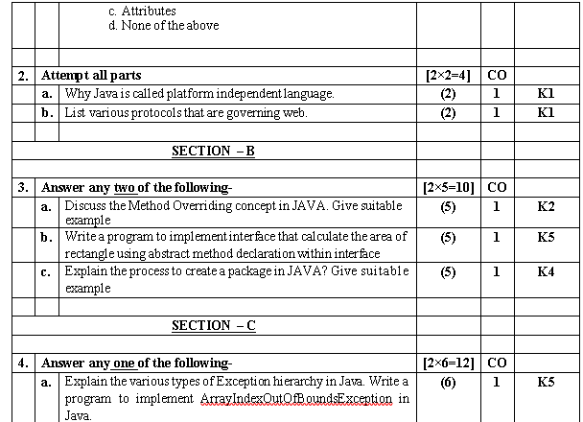
Sessional Papers

Slide 96
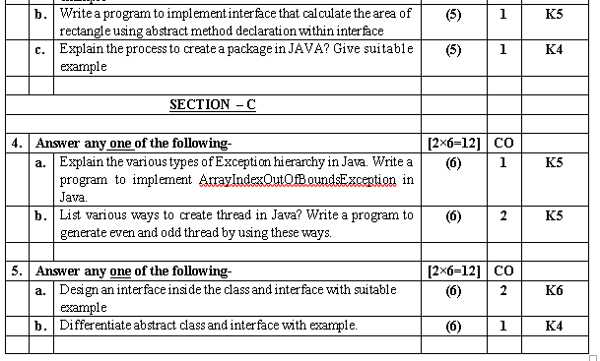
Sessional Papers

Slide 97
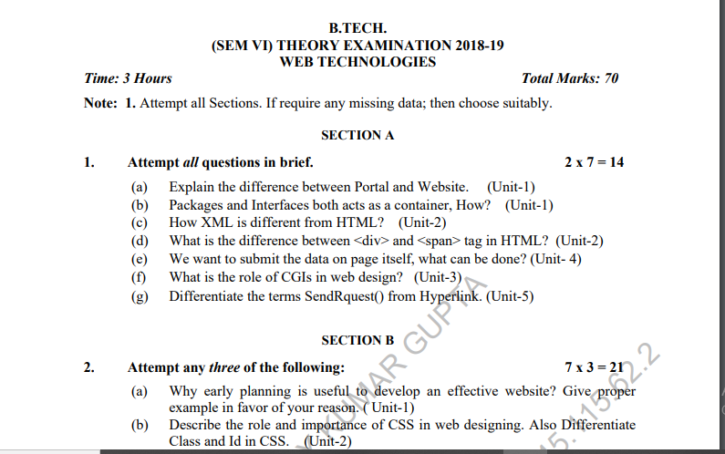
Old Question Paper

Slide 98
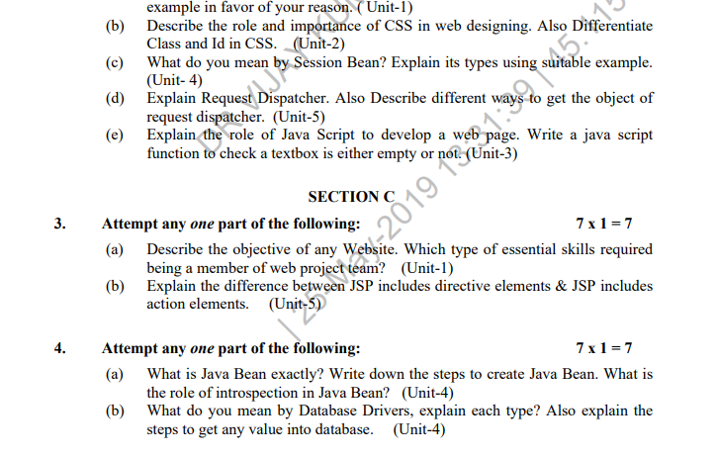
Old Question Paper(cont..)

Slide 99
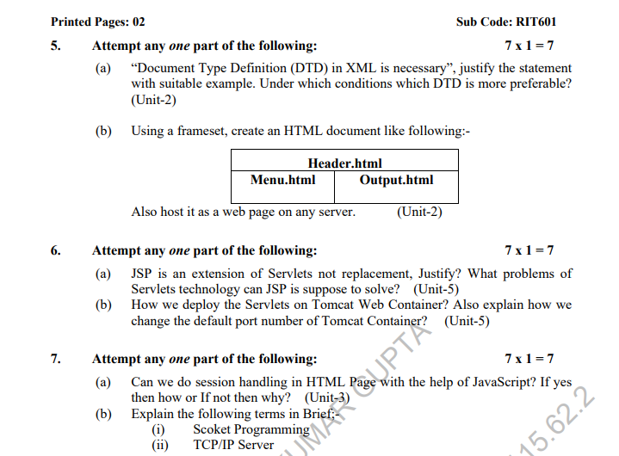
Old Question Paper(cont..)

Slide 100
Expected Questions for University Exam
Discuss the various protocols in details that are governing web
Explain various types of tools available to design a website
Discuss the process involve in web hosting with help of example
Explain the various types server involve in client/server model
Elaborate the complete process for creating Emails in Cpanel.
Discuss various types of hosting packages for registering domains

Slide 101
References
Burdman, Jessica, “Collaborative Web Development” Addison Wesley
Xavier, C, “ Web Technology and Design” , New Age International
Ivan Bayross,” HTML, DHTML, Java Script, Perl & CGI”, BPB Publication

Slide 102
Recap of Unit 1
Discussed about the history of web development strategies and protocols governing web with various types of internet services and tools.
Discussed about various types server with the help of client server computing concepts.
Discussed the various type of hosting packages
Discussed about various protocols governing web

Slide 103
Thank You

